Slide 1
Propositional Equivalences

Slide 2
Agenda
Tautologies
Logical Equivalences

Slide 3
Tautologies, contradictions, contingencies
DEF: A compound proposition is called a tautology if no matter what truth values its atomic propositions have, its own truth value is T.
EG: p ∨ ¬p (Law of excluded middle)
The opposite to a tautology, is a compound proposition that’s always false –a contradiction.
EG: p ∧ ¬p (Law of contradiction)
On the other hand, a compound proposition whose truth value isn’t constant is called a contingency.
EG: p → ¬p
Notes:
Question: why is the last a contingency?

Slide 4
Tautologies and contradictions
The easiest way to see if a compound proposition is a tautology/contradiction is to use a truth table.
p
¬p
p ∨¬p
p
¬p
p ∧¬p
F
T
T
F
T
T
F
T
T
F
F
F

Slide 5
Tautology example
Demonstrate that
[¬p ∧(p ∨q )]→q
is a tautology in two ways:
Using a truth table – show that [¬p ∧(p ∨q )]→q is always true
Using a proof (will get to this later).

Slide 6
Tautology by truth table
p | q | ¬p | p ∨q | ¬p ∧(p ∨q ) | [¬p ∧(p ∨q )]→q
T | T
T | F
F | T
F | F

Slide 7
Tautology by truth table
p | q | ¬p | p ∨q | ¬p ∧(p ∨q ) | [¬p ∧(p ∨q )]→q
T | T | F
T | F | F
F | T | T
F | F | T

Slide 8
Tautology by truth table
p | q | ¬p | p ∨q | ¬p ∧(p ∨q ) | [¬p ∧(p ∨q )]→q
T | T | F | T
T | F | F | T
F | T | T | T
F | F | T | F

Slide 9
Tautology by truth table
p | q | ¬p | p ∨q | ¬p ∧(p ∨q ) | [¬p ∧(p ∨q )]→q
T | T | F | T | F
T | F | F | T | F
F | T | T | T | T
F | F | T | F | F

Slide 10
Tautology by truth table
p | q | ¬p | p ∨q | ¬p ∧(p ∨q ) | [¬p ∧(p ∨q )]→q
T | T | F | T | F | T
T | F | F | T | F | T
F | T | T | T | T | T
F | F | T | F | F | T

Slide 11
Tautologies, contradictions and programming
Tautologies and contradictions in your code usually correspond to poor programming design. EG:
    while(x <= 3 || x > 3)
    x++;
    if(x > y)
    if(x == y)
    return “never got here”;

Slide 12
Logical Equivalences
DEF: Two compound propositions p, q are logically equivalent if their biconditional joining p ↔ q is a tautology. Logical equivalence is denoted by p ⇔ q (p Ξ q).
EG: The contrapositive of a logical implication is the reversal of the implication, while negating both components. I.e. the contrapositive of p →q is ¬q →¬p . As we’ll see next: p →q ⇔ ¬q →¬p

Slide 13
Logical Equivalence of Conditional and Contrapositive
The easiest way to check for logical equivalence is to see if the truth tables of both variants have identical last columns:
p
q
p →q
p
q
¬q
¬p
¬q→¬p
Q: why does this work given definition of ⇔ ?

Slide 14
Logical Equivalence of Conditional and Contrapositive
The easiest way to check for logical equivalence is to see if the truth tables of both variants have identical last columns:
p
q
p →q
p
q
¬q
¬p
¬q→¬p
T
T
F
F
T
F
T
F
T
F
T
T
Q: why does this work given definition of ⇔ ?

Slide 15
Logical Equivalence of Conditional and Contrapositive
The easiest way to check for logical equivalence is to see if the truth tables of both variants have identical last columns:
p
q
p →q
p
q
¬q
¬p
¬q→¬p
T
T
F
F
T
F
T
F
T
F
T
T
T
T
F
F
T
F
T
F
Q: why does this work given definition of ⇔ ?

Slide 16
Logical Equivalence of Conditional and Contrapositive
The easiest way to check for logical equivalence is to see if the truth tables of both variants have identical last columns:
p
q
p →q
p
q
¬q
¬p
¬q→¬p
T
T
F
F
T
F
T
F
T
F
T
T
T
T
F
F
T
F
T
F
F
T
F
T
Q: why does this work given definition of ⇔ ?

Slide 17
Logical Equivalence of Conditional and Contrapositive
The easiest way to check for logical equivalence is to see if the truth tables of both variants have identical last columns:
p
q
p →q
p
q
¬q
¬p
¬q→¬p
T
T
F
F
T
F
T
F
T
F
T
T
T
T
F
F
T
F
T
F
F
T
F
T
F
F
T
T
Q: why does this work given definition of ⇔ ?

Slide 18
Logical Equivalence of Conditional and Contrapositive
The easiest way to check for logical equivalence is to see if the truth tables of both variants have identical last columns:
p
q
p →q
p
q
¬q
¬p
¬q→¬p
T
T
F
F
T
F
T
F
T
F
T
T
T
T
F
F
T
F
T
F
F
T
F
T
F
F
T
T
T
F
T
T
Q: why does this work given definition of ⇔ ?

Slide 19
Logical Equivalences
A: p ⇔q by definition means that p ↔ q is a tautology. Furthermore, the biconditional is true exactly when the truth values of p and of q are identical. So if the last column of truth tables of p and of q is identical, the biconditional join of both is a tautology.

Slide 20
Logical Non-Equivalence of Conditional and Converse
The converse of a logical implication is the reversal of the implication. I.e. the converse of p →q is q →p.
EG: The converse of “If Donald is a duck then Donald is a bird.” is “If Donald is a bird then Donald is a duck.”
As we’ll see next: p →q and q →p are not logically equivalent.

Slide 21
Logical Non-Equivalence of Conditional and Converse
p | q | p →q | q →p | (p →q) ↔ (q →p)

Slide 22
Logical Non-Equivalence of Conditional and Converse
p | q | p →q | q →p | (p →q) ↔ (q →p)
T T F F | T F T F

Slide 23
Logical Non-Equivalence of Conditional and Converse
p | q | p →q | q →p | (p →q) ↔ (q →p)
T T F F | T F T F | T F T T

Slide 24
Logical Non-Equivalence of Conditional and Converse
p | q | p →q | q →p | (p →q) ↔ (q →p)
T T F F | T F T F | T F T T | T T F T

Slide 25
Logical Non-Equivalence of Conditional and Converse
p | q | p →q | q →p | (p →q) ↔ (q →p)
T T F F | T F T F | T F T T | T T F T | T F F T

Slide 26
Derivational Proof Techniques
When compound propositions involve more and more atomic components, the size of the truth table for the compound propositions increases
Q1: How many rows are required to construct the truth-table of:
( (q↔(p→r )) ∧ (¬(s∧r)∨¬t) ) → (¬q→r )
Q2: How many rows are required to construct the truth-table of a proposition involving n atomic components?

Slide 27
Derivational Proof Techniques
A1: 32 rows, each additional variable doubles the number of rows
A2: In general, 2^{n} rows
Therefore, as compound propositions grow in complexity, truth tables become more and more unwieldy. Checking for tautologies/logical equivalences of complex propositions can become a chore, especially if the problem is obvious.

Slide 28
Derivational Proof Techniques
EG: consider the compound proposition
(p →p ) ∨ (¬(s∧r)∨¬t) ) ∨ (¬q→r )
Q: Why is this a tautology?

Slide 29
Derivational Proof Techniques
A: Part of it is a tautology (p →p ) and the disjunction of True with any other compound proposition is still True:
(p →p ) ∨ (¬(s∧r)∨¬t )) ∨ (¬q→r )
T ∨ (¬(s∧r)∨¬t )) ∨ (¬q→r )
T
Derivational techniques formalize the intuition of this example.

Slide 30
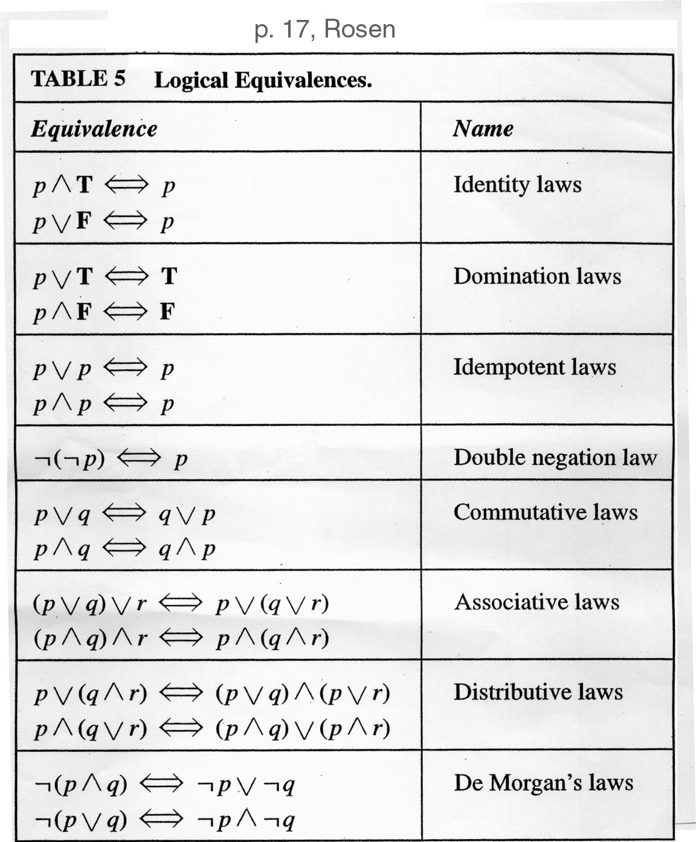
Tables of Logical Equivalences
    Identity laws
      Like adding 0
    Domination laws
      Like multiplying by 0
    Idempotent laws
      Delete redundancies
    Double negation
      “I don’t like you, not”
    Commutativity
      Like “x+y = y+x”
    Associativity
      Like “(x+y)+z = y+(x+z)”
    Distributivity
      Like “(x+y)z = xz+yz”
    De Morgan

Slide 31
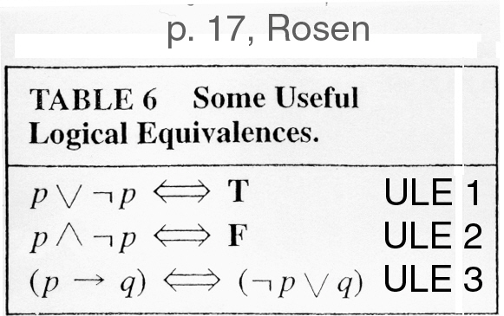
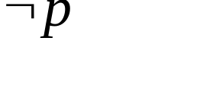
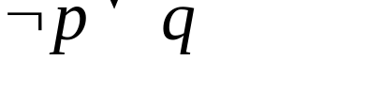
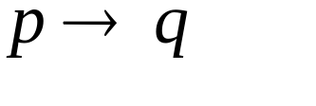
Tables of Logical Equivalences
    Excluded middle
    Negating creates opposite
    Definition of implication in terms of Not and Or
p
q
0
0
1
1
0
1
0
1
1
1
0
0
1
1
0
1
1
1
0
1

Slide 32
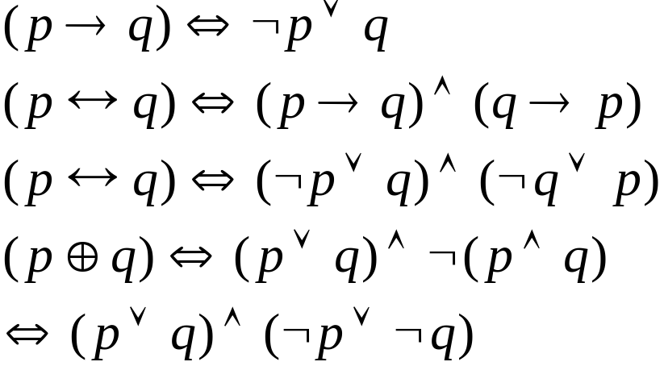


Logical Equivalences
The Laws of Logic
logically equivalent
We can eliminate the connectives
and
from compound statements.
(and,or,not) is a complete set.

Slide 33
DeMorgan Identities
DeMorgan’s identities allow for simplification of negations of complex expressions
Conjunctional negation:
  ¬(p₁∧p₂∧…∧p_{n}) ⇔ (¬p₁∨¬p₂∨…∨¬p_{n})
  “It’s not the case that all are true iff one is false.”
Disjunctional negation:
  ¬(p₁∨p₂∨…∨p_{n}) ⇔ (¬p₁∧¬p₂∧…∧¬p_{n})
  “It’s not the case that one is true iff all are false.”

Slide 34
Tautology example
Demonstrate that
[¬p ∧(p ∨q )]→q
is a tautology in two ways:
Using a truth table
Using a proof through a series of logical equivalences

Slide 35
Tautology by proof
[¬p ∧(p ∨q )]→q

Slide 36
Tautology by proof
[¬p ∧(p ∨q )]→q
⇔ [(¬p ∧p)∨(¬p ∧q)]→q Distributive

Slide 37
Tautology by proof
[¬p ∧(p ∨q )]→q
⇔ [(¬p ∧p)∨(¬p ∧q)]→q Distributive
⇔ [ F ∨ (¬p ∧q)]→q ULE

Slide 38
Tautology by proof
[¬p ∧(p ∨q )]→q
⇔ [(¬p ∧p)∨(¬p ∧q)]→q Distributive
⇔ [ F ∨ (¬p ∧q)]→q ULE
⇔ [¬p ∧q ]→q Identity

Slide 39
Tautology by proof
[¬p ∧(p ∨q )]→q
⇔ [(¬p ∧p)∨(¬p ∧q)]→q Distributive
⇔ [ F ∨ (¬p ∧q)]→q ULE
⇔ [¬p ∧q ]→q Identity
⇔ ¬ [¬p ∧q ] ∨ q ULE

Slide 40
Tautology by proof
[¬p ∧(p ∨q )]→q
⇔ [(¬p ∧p)∨(¬p ∧q)]→q Distributive
⇔ [ F ∨ (¬p ∧q)]→q ULE
⇔ [¬p ∧q ]→q Identity
⇔ ¬ [¬p ∧q ] ∨ q ULE
⇔ [¬(¬p)∨ ¬q ] ∨ q DeMorgan

Slide 41
Tautology by proof
[¬p ∧(p ∨q )]→q
⇔ [(¬p ∧p)∨(¬p ∧q)]→q Distributive
⇔ [ F ∨ (¬p ∧q)]→q ULE
⇔ [¬p ∧q ]→q Identity
⇔ ¬ [¬p ∧q ] ∨ q ULE
⇔ [¬(¬p)∨ ¬q ] ∨ q DeMorgan
⇔ [p ∨ ¬q ] ∨ q Double Negation

Slide 42
Tautology by proof
[¬p ∧(p ∨q )]→q
⇔ [(¬p ∧p)∨(¬p ∧q)]→q Distributive
⇔ [ F ∨ (¬p ∧q)]→q ULE
⇔ [¬p ∧q ]→q Identity
⇔ ¬ [¬p ∧q ] ∨ q ULE
⇔ [¬(¬p)∨ ¬q ] ∨ q DeMorgan
⇔ [p ∨ ¬q ] ∨ q Double Negation
⇔ p ∨ [¬q ∨q ] Associative

Slide 43
Tautology by proof
[¬p ∧(p ∨q )]→q
⇔ [(¬p ∧p)∨(¬p ∧q)]→q Distributive
⇔ [ F ∨ (¬p ∧q)]→q ULE
⇔ [¬p ∧q ]→q Identity
⇔ ¬ [¬p ∧q ] ∨ q ULE
⇔ [¬(¬p)∨ ¬q ] ∨ q DeMorgan
⇔ [p ∨ ¬q ] ∨ q Double Negation
⇔ p ∨ [¬q ∨q ] Associative
⇔ p ∨ [q ∨¬q ] Commutative

Slide 44
Tautology by proof
[¬p ∧(p ∨q )]→q
⇔ [(¬p ∧p)∨(¬p ∧q)]→q Distributive
⇔ [ F ∨ (¬p ∧q)]→q ULE
⇔ [¬p ∧q ]→q Identity
⇔ ¬ [¬p ∧q ] ∨ q ULE
⇔ [¬(¬p)∨ ¬q ] ∨ q DeMorgan
⇔ [p ∨ ¬q ] ∨ q Double Negation
⇔ p ∨ [¬q ∨q ] Associative
⇔ p ∨ [q ∨¬q ] Commutative
⇔ p ∨ T ULE

Slide 45
Tautology by proof
[¬p ∧(p ∨q )]→q
⇔ [(¬p ∧p)∨(¬p ∧q)]→q Distributive
⇔ [ F ∨ (¬p ∧q)]→q ULE
⇔ [¬p ∧q ]→q Identity
⇔ ¬ [¬p ∧q ] ∨ q ULE
⇔ [¬(¬p)∨ ¬q ] ∨ q DeMorgan
⇔ [p ∨ ¬q ] ∨ q Double Negation
⇔ p ∨ [¬q ∨q ] Associative
⇔ p ∨ [q ∨¬q ] Commutative
⇔ p ∨ T ULE
⇔ T Domination

Slide 46
Examples
Worked out on the black-board.
“I don’t drink and drive” is logically equivalent to “If I drink, then I don’t drive”
Write a C method that represents the compound proposition (p→q)←→r

